Slide 1
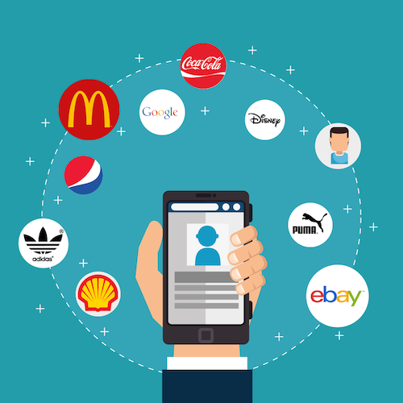
Customer Support Chatbot
BYGB 7977-002 Text Analytics
Group 8
Team Members: Yilin Wen, Yonglin Liu, Kuo Song, Elif Aydin
04/22/2020
Notes:
Im pleased to present an interesting project about customer support chatbot on behalf of our group

Slide 2
Problem Statement
Build a customer service chatbot to immediately respond to customers’ queries
Since manual data analysis requires a huge amount of time and excessive resources, building a customer service chatbot could be extremely useful for companies to deal with customer concerns efficiently
Companies that use Twitter as a social care channel are seeing a 19% increase in customer satisfaction
Notes:
The main task is to build a chatbot to deal with customers’ inquiries on social media platforms such as Twitter and Facebook. The answer from the chatbot will also consider the tone of the chat conversation.

Slide 3

Data Collection & Description
Dataset: Customer Support on Twitter
3 million tweets and replies from the biggest brands (e.g. Apple, Amazon, Uber) on Twitter
Data source: downloaded from Kaggle
Every conversation included has at least one request from a consumer and at least one response from a company
Notes:
The dataset we use is from Kaggle and it’s about tweets of customers and replies from customer support teams from the biggest brands on twitter.

Slide 4
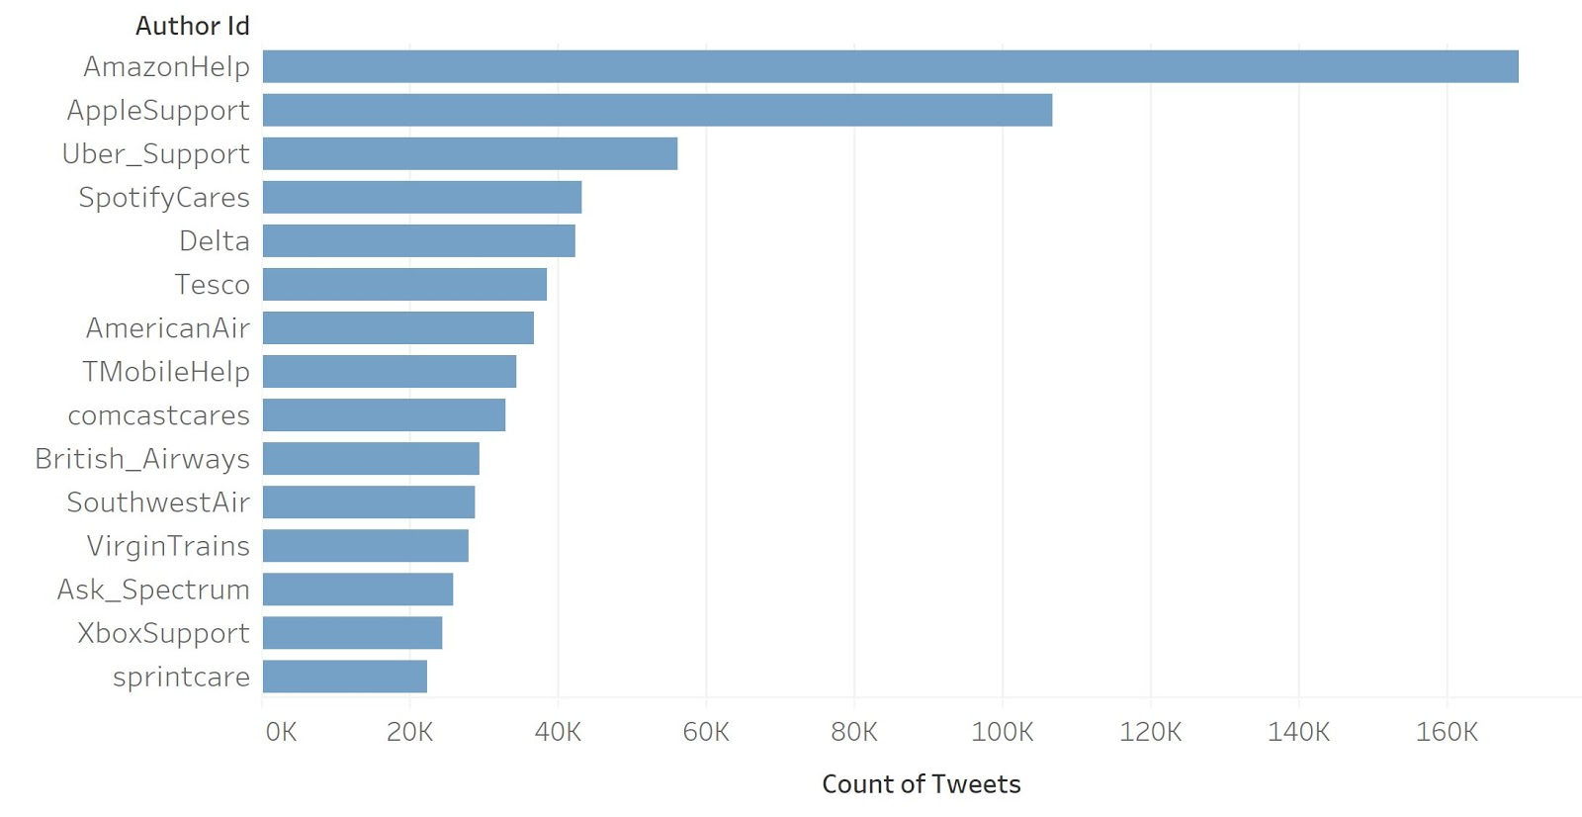
Descriptive Analytics
Amazon and Apple were the two most responsive companies, followed by Uber, Spotify, and Delta
This project focused on building the chatbots for Amazon, Apple and Uber only

Slide 5
Methodology Flow Chart
Text Preprocessing
Tokenization,
Stop words removal,
Stemming
Customer Support on Twitter dataset
Or
New queries
Feature Extraction (Vectorization)
TFIDF,
Word2Vec,
LSI, LDA
Matrix Similarity
Response
Topic Modeling
LDA
Conclusion & Implications
Notes:
retrieval-based models: chatbot uses ML-based approach to select a response from a library of predefined responses. Here’s a flow chart illustrating the methodology process. Ill go over them in a min.

Slide 6
Data Preprocessing
Removed @ symbols and user IDs
Grouped tweets by different companies
Paired questions and responses into same rows
Tokenization
Transition of cases
Stop words removal VS Stemming
Notes:
In terms of data preprocessing, we will break down text into words using tokenization, convert the entire text into uppercase or lowercase, eliminate stop words, normalize the words into stems

Slide 7
Vectorization
Four encoding methods:
Word2Vec,
TFIDF,
LSI (Latent Semantic Analysis),
LDA (Latent Dirichlet Allocation)
Cosine Similarity: determine the response based on how similar the requests are
Used Matrix Similarity function in Gensim to calculate cosine similarity
Manually calculated cosine similarity for Word2Vec

Slide 8
How does the chatbot work?
Choose the encoding methods (Word2Vec, TFIDF, LSI or LDA)
Select the company (Amazon, Apple or Uber)
Enter question
Return the answer based on the most similar question
Return the next most similar answer
if the previous answer did not solve the problem
Return five most similar questions and similarity scores
If similarity score below 0.5, the chatbot will suggest to contact human service
Notes:
Here’s a list of columns in the dataset. Key variable we gonna focus on is the text column

Slide 9
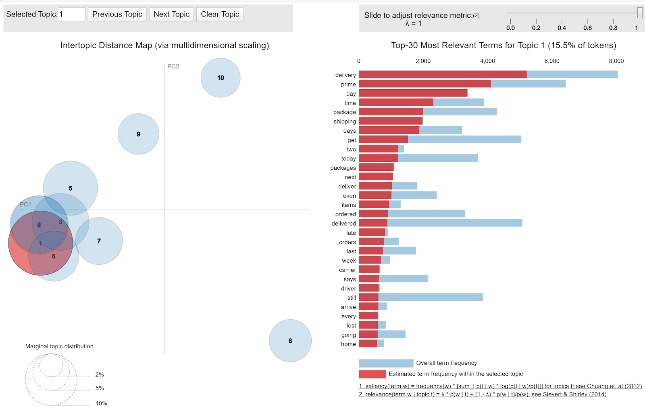
Topic Modeling using LDA for Amazon
Package delivery time is a major concern for Amazon users
One frequently asked question could be
‘I selected free two day delivery but the package arrived late’
Used as a query to test the results of the chatbot
Notes:
Here’s a list of columns in the dataset. Key variable we gonna focus on is the text column

Slide 10
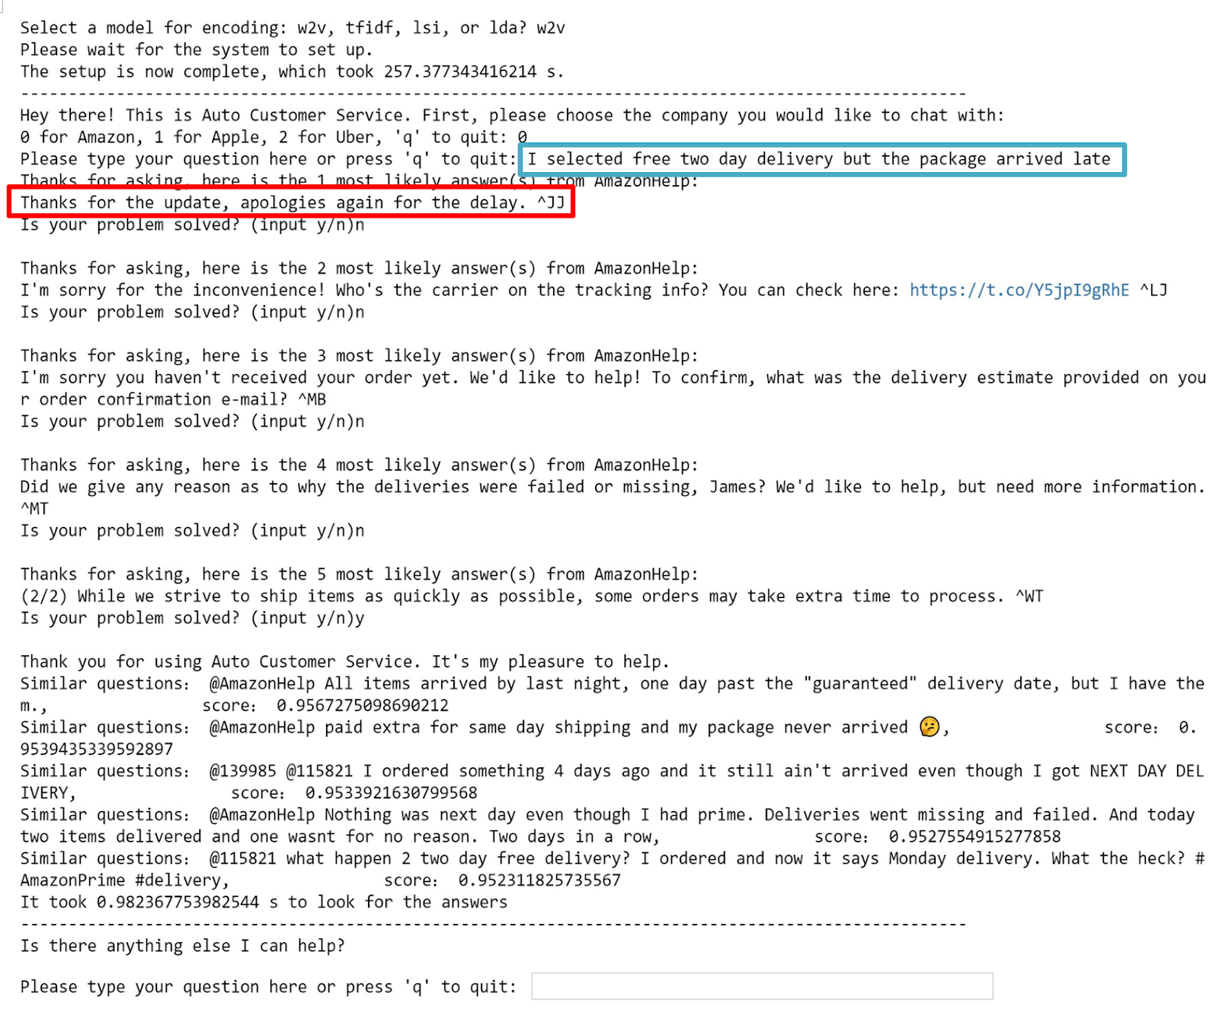
Results for Word2vec
Z
The most similar question suggested was not the same question as the input
The other 4 similar questions are about package delay and the answers are relevant
Similarity scores all above 0.95, we may set higher threshold
Notes:
Here’s a list of columns in the dataset. Key variable we gonna focus on is the text column

Slide 11
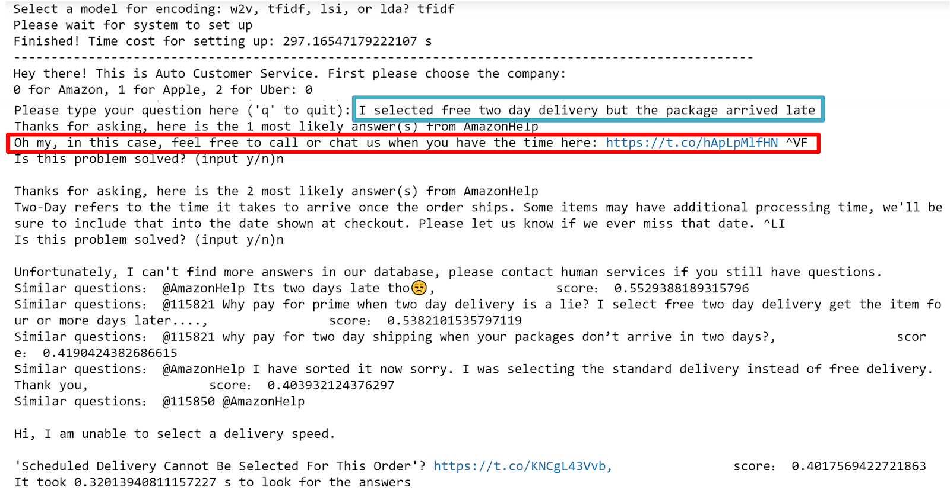
Results for TFIDF
Z
Returned only two responses with similarity above 0.5
The third question was more relevant than the first, but answer didn’t return
Lower the threshold to around 0.4
Notes:
Here’s a list of columns in the dataset. Key variable we gonna focus on is the text column

Slide 12
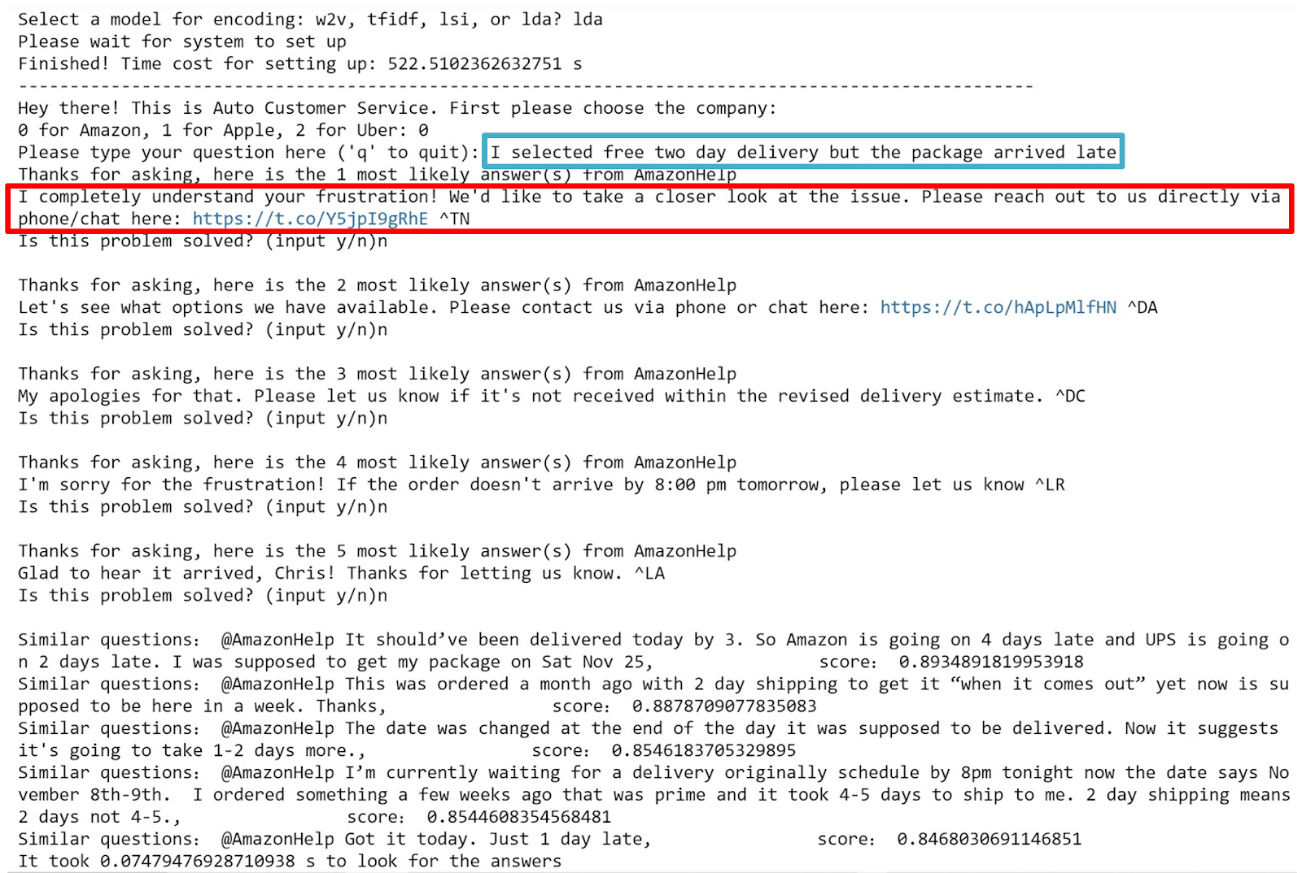
Results for LDA
Z
All questions are to do with package delay, but only the second and the fourth mentioned 2-day shipping
First four answers scored above 0.85 are relevant
Adjust threshold to around 0.85
Notes:
Here’s a list of columns in the dataset. Key variable we gonna focus on is the text column

Slide 13
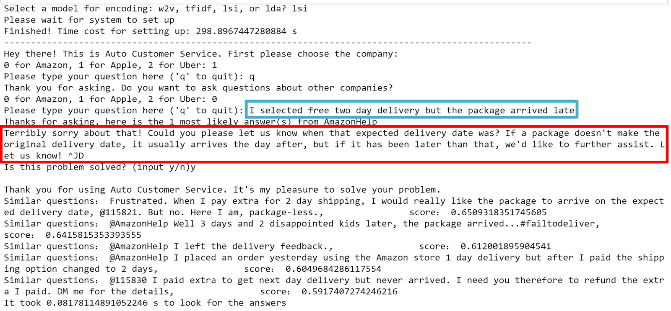
Results for LSI
Z
The most similar question delivered the same meaning as input question -delay of two-day shipping
The first answer scored 0.65 was relevant and professional
Notes:
Here’s a list of columns in the dataset. Key variable we gonna focus on is the text column

Slide 14
Conclusions
Built a retrieval-based chatbot for Amazon, Apple and Uber
Applied Word2vec, TFIDF, LSI and LDA algorithms to select responses from historic replies from the customer service teams
LSI provided the most professional answer and computed the most similar question as input question, based on the testing example

Slide 15
Recommendation
Companies may consider applying LSI to build a customer service chatbot.
Amazon should pay attention to the common package delay, lost and return problems.
One possible solution may be to hire more delivery staff by increasing logistics cost and better managing the supply chain.

Slide 16
Thank you! Any questions?

